Slide 1
Kelgyó PROJECT
By: Simon Roland, kocsis balázs, roben rómeó
Presented by: roben rómeó

Slide 2
Preparations
First we gathered ideas what to make
We settled with the snake game
Then we moved on to assing tasks for everyone

Slide 3
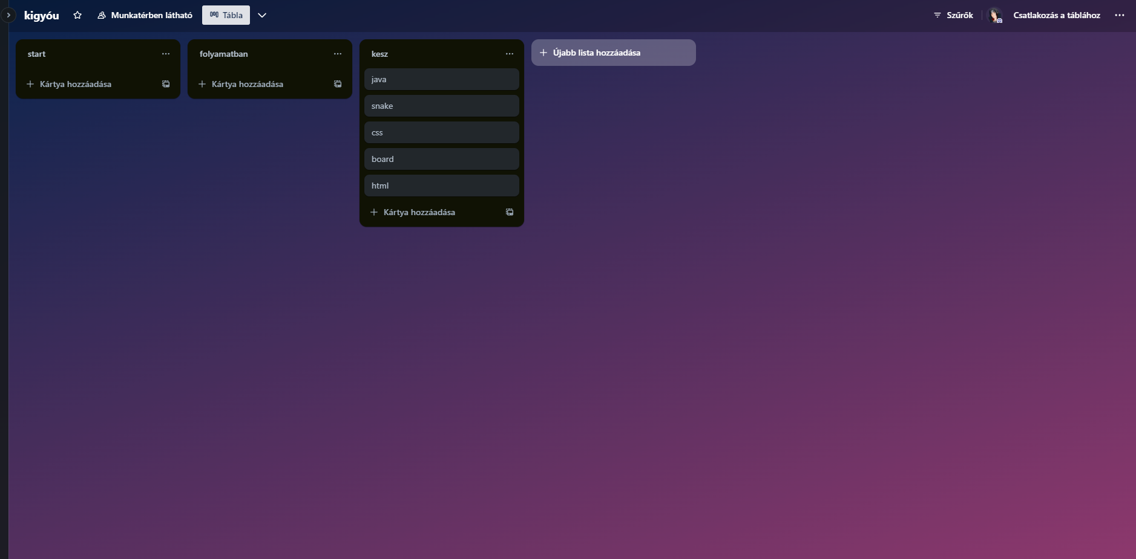
Trello

Slide 4
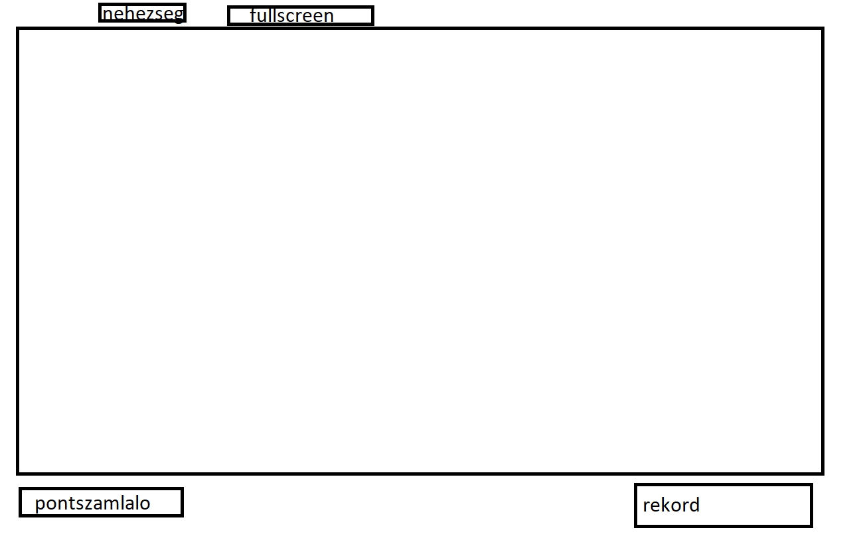
Wireframe

Slide 5
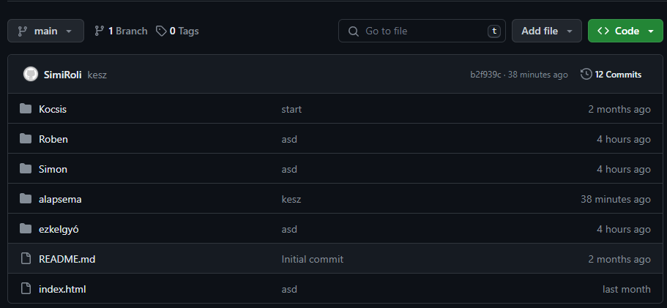
Github

Slide 6
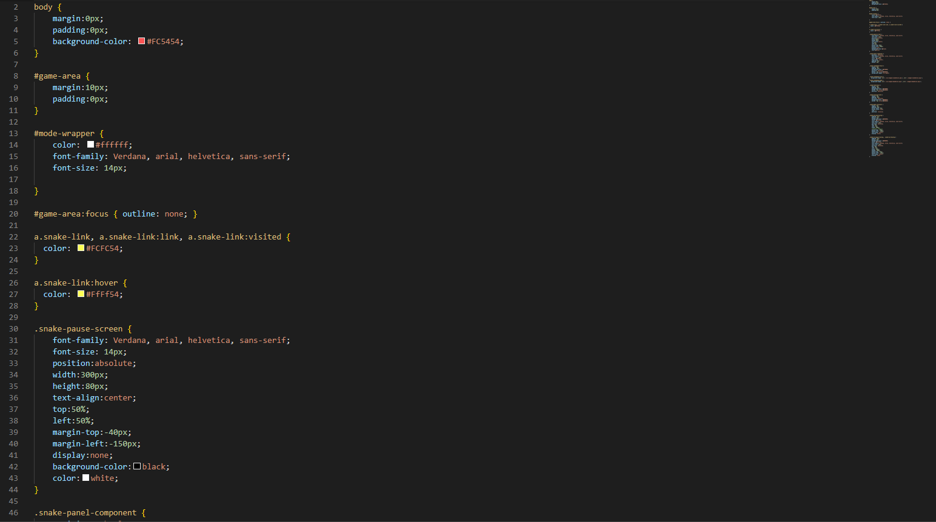

Slide 7
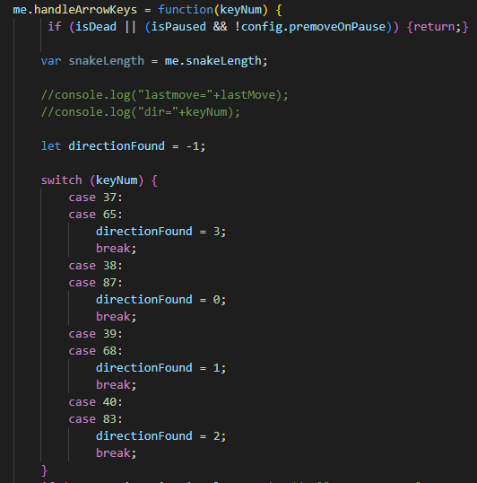
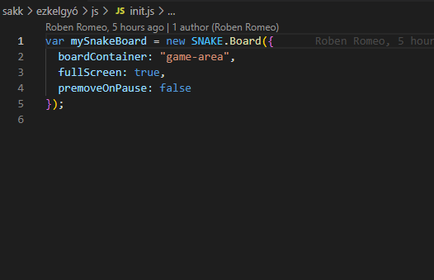

Slide 8
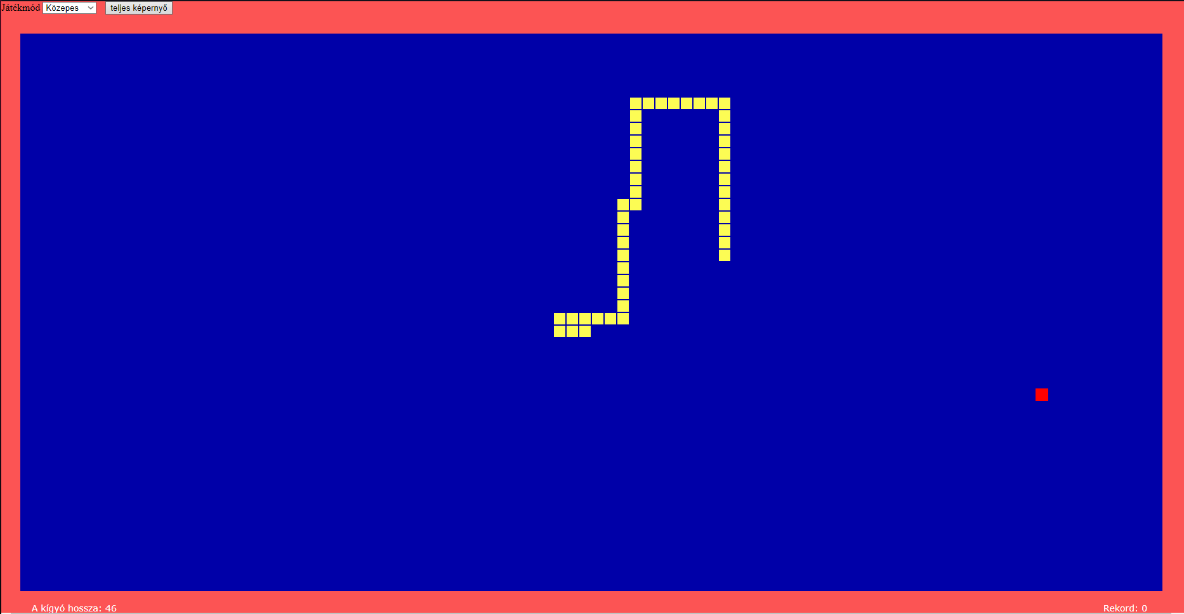

Slide 9
Thank you for your attention!

